Slide 1
Deep Learning
Transformers
Chapter 11.4
Vera Hollink
2025

Slide 2
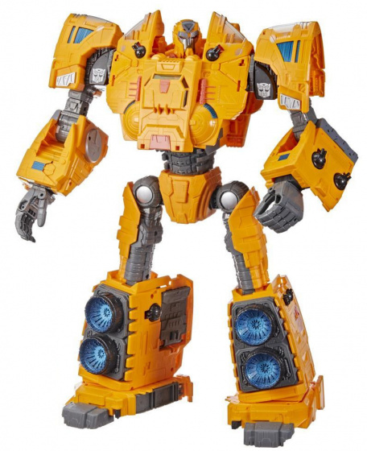
Deep Learning models for text
Dense models
Recurrent Neural Networks
Encoder-decoders
Transformers

Slide 3

Neural attention

Slide 4
Focus your attention
Some features are more important than others
Text
Tf.idf more important words get more weight
Images
Convnet max pooling keep places where pattern is present, ignore places where it is not present.

Slide 5
Neural attention
Idea: context words determine the meaning of a word
I saw a bat in a cave.
I hit the ball with a bat.
Pay attention to important words
e.g. next word, subject of sentence
Context words influence the word vector
pull word vector towards vectors of attention words
bat-vector becomes more like cave-vector (or ball-vector)

Slide 6
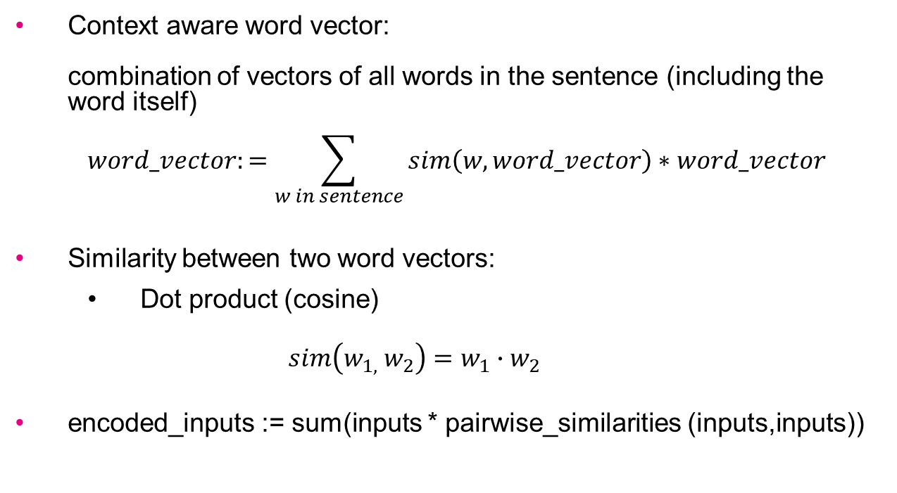
Neural attention
Context aware word vector: combination of vectors of all words in the sentence (including the word itself)
$$word_vector:=\sum_{w in sentence}{sim\left(w, word_vector\right)∗word_vector}$$
Similarity between two word vectors:
Dot product (cosine)
$$sim\left(w_{1,} w_{2}\right)={w_{1}∙w}_{2}$$
encoded_inputs := sum(inputs * pairwise_similarities (inputs,inputs))
Notes:
dot product gives relevance of word to otherword (highest for word itself)
Some normalization is left out for simplicity

Slide 7
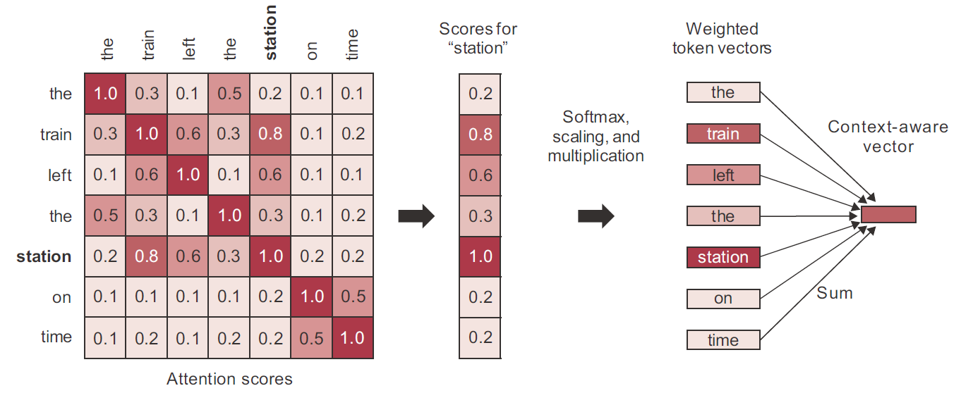

Neural attention
$$word_vector:=\sum_{w in sentence}{sim\left(w, word_vector\right)∗word_vector}$$
the train left the station on time
Notes:
dot product gives relevance of word to otherword (highest for word itself)
Some normalization is left out for simplicity

Slide 8
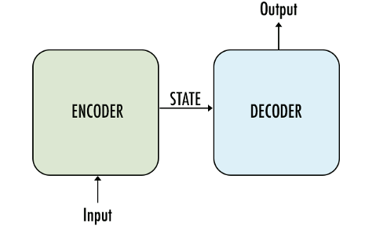
Neural attention
Use attention to create context aware embedding vector for each word.
Output sequence of context aware vectors as encoded input.
encoded input

Slide 9
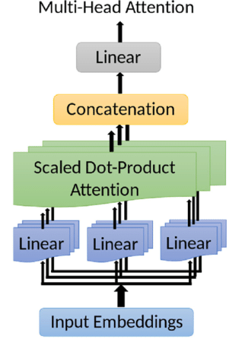
Multiple attention heads
multiple embeddings ➔ multiple attentions
e.g. next word, subject
layers.MultiHeadAttention( num_heads=3, key_dim=embed_dim)
3 attention points
length of input word embedding vector

Slide 10
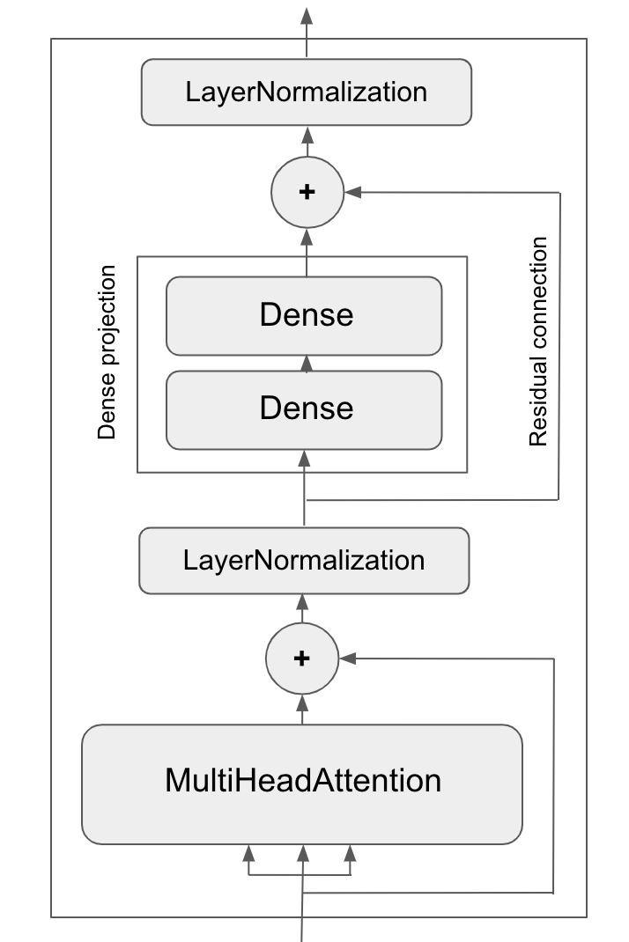
Transformer encoder architecture
Multiple attention heads (embeddings)
Concatenate output of heads
Dense network
Residual connection to keep output attention heads
Normalization (scaling)

Slide 11
Including word order
Is word order used?
Input sequence is processed as a whole
Solution:
Positional embeddings

Slide 12
Positional embeddings
Encode positions of words
Words: [the, mouse, loves, apples]
Positions: 0 1 2 3
1. fixed encodings
embedded_positions = f(positions)
2. Learn embedding
embedded_positions = layers.Embedding(positions)
Input for encoder: sentence_embedding = embedded_tokens + embedded_positions
Outputs a matrix: sequence_length x embed_dim

Slide 13
Transformer encoder with positional embedding for text classification
inputs = keras.Input(shape=(None,), dtype="int64")
x = PositionalEmbedding(sequence_length, vocab_size, embed_dim)(inputs)
x = TransformerEncoder(embed_dim, dense_dim, num_heads)(x)
x = layers.GlobalMaxPooling1D()(x)
x = layers.Dropout(0.5)(x)
outputs = layers.Dense(1, activation="sigmoid")(x)
For classification reduce output sequence to a single vector

Slide 14
Full transformer architecture

Slide 15
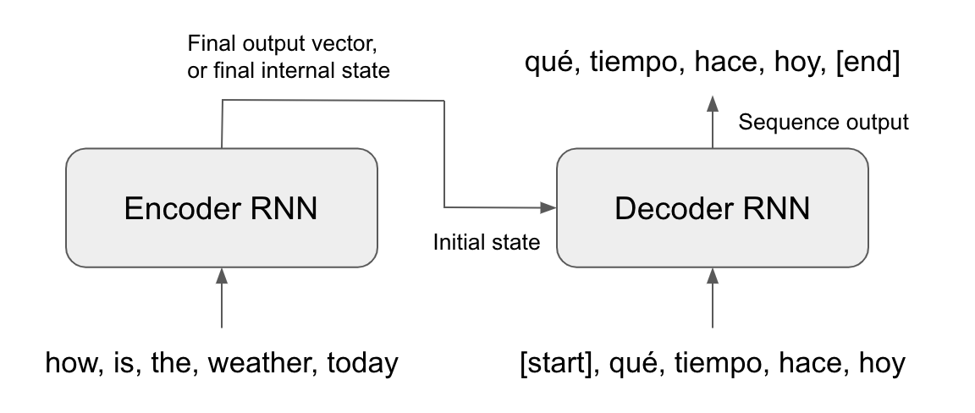
Compare: RRN encoder/decoder architecture
Encoder: input ➔ internal representation
Decoder: internal representation + generated sequence so far ➔ output
single state vector represents the whole source sequence

Slide 16
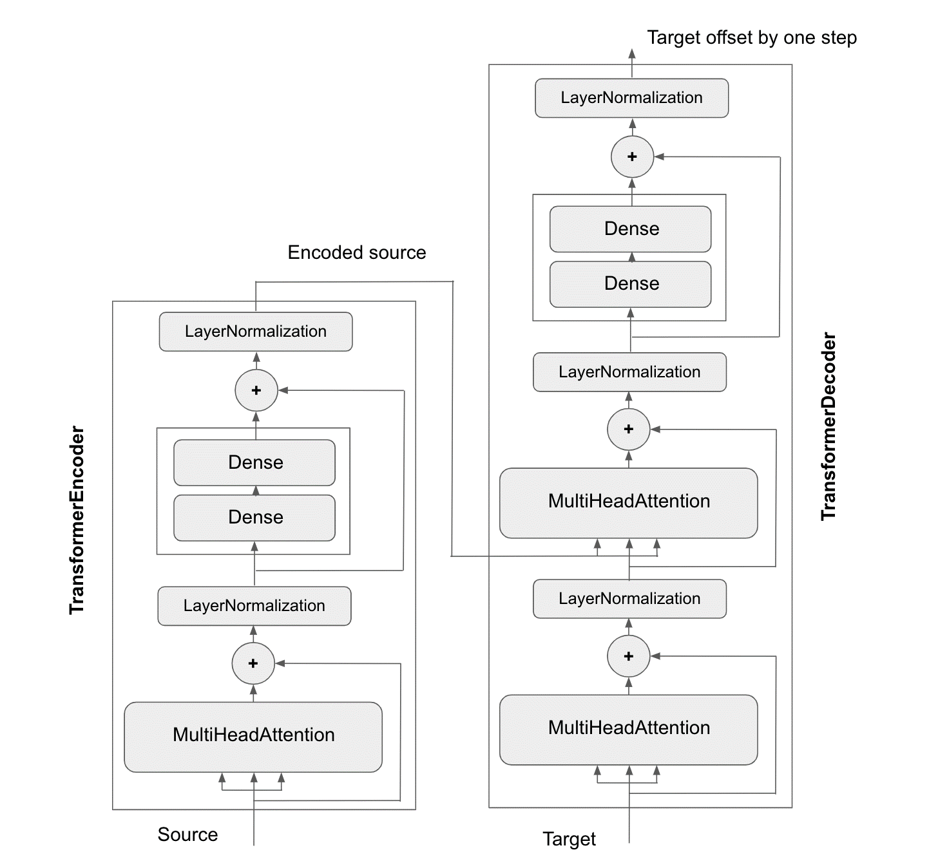
Dummy
Transformer
sequence of embedding vectors represent the source sequence
two multihead attention layers

Slide 17
Transformer architecture
Encoder: multihead attention
Context aware encoding of source sequence
Decoder: multihead attention 1:
context aware encoding of output sequence so far
multihead attention 2:
encoding of output sequence so far + encoding of source sequence → encoding of source sequence so far output sequence so far determines attention points in the source sequence
Notes:
attention_output_2 = self.attention_2(
query=attention_output_1,
value=encoder_outputs,
key=encoder_outputs,
outputs = sum(v a l u e s * p a i r w i s e s c o r e s (q u e r y , k e y s ))

Slide 18
Transformer decoder
Output sequence so far determines attention points in the source sequence
Example:
Source: [Heb, je, de, kat, ergens, gezien, ?]
(Have you seen the cat anywhere?)
Output so far: [Have]
Output so far: [Have, you]
Output so far: [Have, you, seen]
most attention on the subject in the source
most attention on the main verb in the source
next element will be the subject
next element will be the main verb

Slide 19
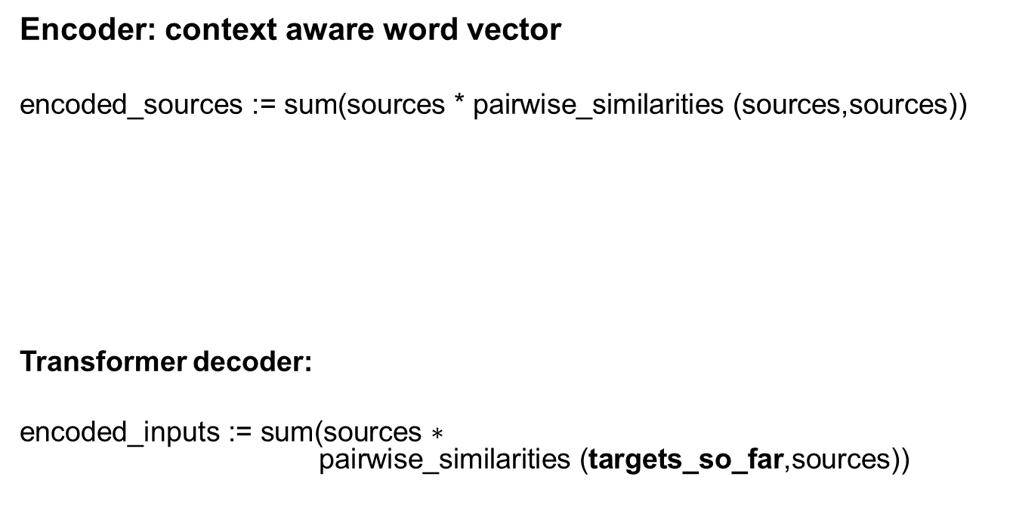
Neural attention in transformers
Encoder: context aware word vector
$$\text{encoded}\text{_}\text{sources}\text{ := }\text{sum}\text{(}\text{sources}\text{ ∗ }\text{pairwise}\text{_}\text{similarities}\text{ (}\text{sources}\text{,}\text{sources}\text{))}$$
Transformer decoder:
$$\text{encoded}\text{_}\text{inputs}\text{ := }\text{sum}\text{(}\text{sources}\text{ ∗ }$$ $\text{pairwise}\text{_}\text{similarities}\text{ (}\text{targets}\text{_}\text{so}\text{_}\text{far}\text{,}\text{sources}\text{))}$
sequence of vectors where each vector represents a source word
similarity of source words to surrounding source words
value
query
(key)
similarity of source words to output words
Notes:
Key is usually the same as value

Slide 20
Transformer encoder-decoder with positional embedding for translation
encoder_inputs = keras.Input(shape=(None,), dtype="int64", name="english")
x = PositionalEmbedding(sequence_length, vocab_size, embed_dim)(encoder_inputs)
encoder_outputs = TransformerEncoder(embed_dim, dense_dim, num_heads)(x)
decoder_inputs = keras.Input(shape=(None,), dtype="int64", name="spanish")
x = PositionalEmbedding(sequence_length, vocab_size, embed_dim)(decoder_inputs)
x = TransformerDecoder(embed_dim, dense_dim, num_heads)(x, encoder_outputs)
x = layers.Dropout(0.5)(x)
decoder_outputs = layers.Dense(vocab_size, activation="softmax")(x)
Notes:
dot product gives relevance of word to otherword (highest for word itself)
Some normalization is left out for simplicity

Slide 21
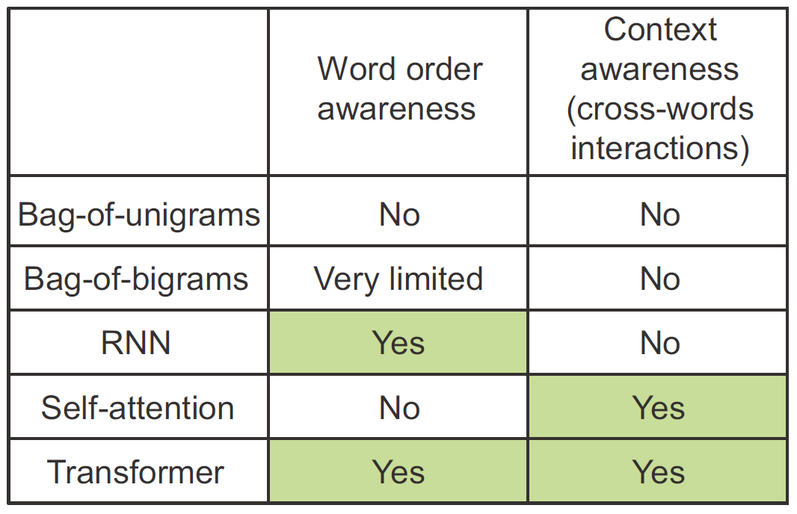
Comparison of text processing architectures

Slide 22
Comparison of text processing architectures
Dense network on bag-of-words
Simple classification: word order not very important
RNN
Advanced classification
Transformer
Advanced classification
Sequence-to-sequence learning

Slide 23
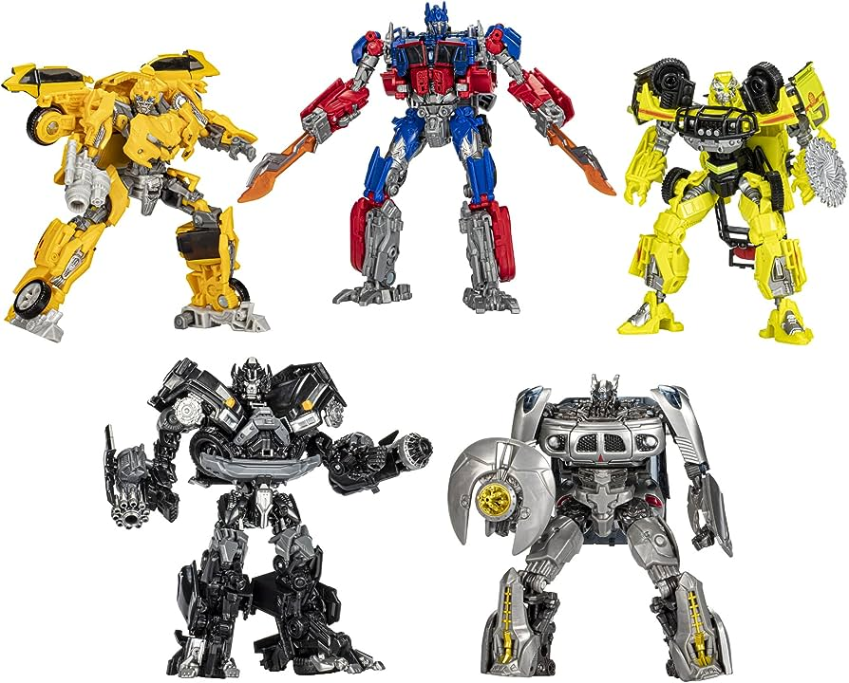
Questions?

